Slide 1
Data Structures
Binary Search Trees

Slide 2
Binary search tree (BST)
If a binary tree has the property that all elements in the left subtree of a node n are lesser than the contents of n and all elements in the right sub-tree are greater than or equal to the contents of n, such a binary tree is called a binary search tree (BST).
In a BST, if the same elements are inserted, then the same element is inserted on the right side of the node, having the same value.

Slide 3
Binary Search Trees
Tree representation:
A linked data structure in which each node is an object
Node representation:
Key field
Satellite data
Left: pointer to left child
Right: pointer to right child
Satisfies the binary-search-tree property !!
Data
key
L
R
Left child
Right child

Slide 4
Binary Search Tree Property
Binary search tree property:
If y is in left subtree of x,
then y->key < x->key
If y is in right subtree of x,
then y->key ≥ x->key
5
3
7
2
5
9

Slide 5
Binary Search Trees
Support many dynamic set operations
TRAVERSE, SEARCH
MINIMUM
MAXIMUM
PREDECESSOR
SUCCESSOR
INSERT
DELETE

Slide 6
Traversing a Binary Search Tree
Inorder tree walk:
Root is printed between the values of its left and right subtrees: left, root, right
Keys are printed in sorted order
Preorder tree walk:
root printed first: root, left, right
Postorder tree walk:
root printed last: left, right, root
5
3
7
2
5
9
Inorder: 2 3 5 5 7 9
Preorder: 5 3 2 5 7 9
Postorder: 2 5 3 9 7 5

Slide 7
Searching for a Key
Given a pointer to the root of a tree and a key k:
Return a pointer to a node with key k
if one exists
Otherwise return NULL
Idea
Starting at the root: trace down a path by comparing k with the key of the current node:
If the keys are equal: we have found the key
If k < x->key search in the left subtree of x
If k > x->key search in the right subtree of x
5
3
7
2
4
9

Slide 8
Example: TREE-SEARCH
15
Search for key 13:
15 → 6 → 7 → 13
6
18
3
7
17
20
2
4
13
9

Slide 9
Searching for a Key
5
Alg: TREE-SEARCH(x, k)
if x = NULL or k = x->key
then return x
if k < x->key
then return TREE-SEARCH(x->left, k )
else return TREE-SEARCH(x->right, k )
3
7
2
4
9

Slide 10
Finding the Minimum in a Binary Search Tree
Goal: find the minimum value in a BST
Following left child pointers from the root, until a NULL is encountered
Alg: TREE-MINIMUM(x)
while x->left ≠ NULL
do x ← x->left
return x
15
6
18
3
7
17
20
2
4
13
9
Minimum = 2

Slide 11
Finding the Maximum in a Binary Search Tree
Goal: find the maximum value in a BST
Following right child pointers from the root, until a NIL is encountered
Alg: TREE-MAXIMUM(x)
while x->right ≠ NULL
do x ← x->right
return x
15
6
18
3
7
17
20
2
4
13
9
Maximum = 20

Slide 12
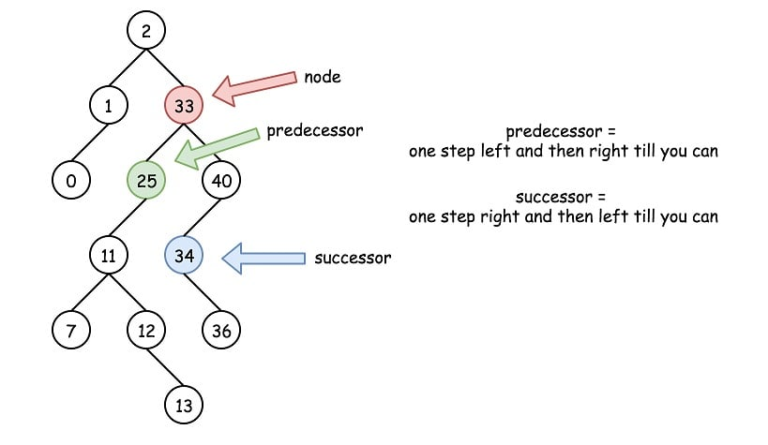

Slide 13
Successor
Def: successor (x ) = y, such that y->key is the smallest key > x->key
E.g.: successor (15) = 17
successor (13) = 15
successor (9) = 13
Case 1: x->right is non empty
successor (x ) = the minimum in x->right
Case 2: x->right is empty
go up the tree until the current node is a left child: successor (x ) is the parent of the current node
if you cannot go further (and you reached the root): x is the largest element
15
6
18
3
7
17
y
20
x
2
4
13
9

Slide 14
Finding the Successor
Alg: TREE-SUCCESSOR(x)
if x->right ≠ NULL
then return TREE-MINIMUM(X->right)
y ← parent[x]??
while y ≠ NULL and x = y->right
do x ← y
y ← parent[y]
return y
15
y
6
18
3
7
17
20
x
2
4
13
9

Slide 15
Predecessor
Def: predecessor (x ) = y, such that y->key is the biggest key < x->key
E.g.: predecessor (15) = 13
predecessor (9) = 7
predecessor (7) = 6
Case 1: x->left is non empty
predecessor (x ) = the maximum in left (x)
Case 2: x->left is empty
go up the tree until the current node is a right child:
predecessor (x ) is the parent of the current node
if you cannot go further (and you reached the root): x is the smallest element
15
y
x
6
18
3
7
17
20
2
4
13
9

Slide 16
Insertion
12
Insert value 13
5
18
2
9
15
19
If x->key < v move to the right child of x,
else move to the left child of x
When x is NULL, we found the correct position
If v < y->key insert the new node as y’s left child
else insert it as y’s right child
Beginning at the root, go down the tree and maintain:
Pointer x : traces the downward path (current node)
Pointer y : parent of x (“trailing pointer” )
1
3
13
17

Slide 17
Example: TREE-INSERT
Insert 13:
x=root[T], y=NULL
y
12
12
x
5
18
5
18
2
9
15
19
2
9
15
19
1
3
17
1
3
17
12
12
x
y
5
18
5
18
2
9
15
19
2
9
15
19
1
3
17
1
3
13
17
x = NULL
y = 15

Slide 18
Alg: TREE-INSERT(T, z)
12
y ← NULL
x ← root [T]
while x ≠ NULL
do y ← x
if z->key < x->key
then x ← x->left
else x ← x->right
if y = NULL
then root [T] ← z Tree T was empty
else if z->key < y->key
then y->left ← z
else y->right ← z
5
18
2
9
15
19
1
3
13
17

Slide 19
Deletion
Goal:
Delete a given node z from a binary search tree
Idea:
Case 1: z has no children
Delete z by making the parent of z point to NIL
15
15
5
16
5
16
3
12
20
3
12
20
z
10
13
18
23
10
18
23
6
delete
6
7
7

Slide 20
Deletion
Case 2: z has one child
Delete z by making the parent of z point to z’s child, instead of to z
15
delete
15
z
5
16
5
20
3
12
20
3
12
18
23
10
13
18
23
10
6
6
7
7

Slide 21
Deletion
Case 3: z has two children
z’s successor (y) is the minimum node in z’s right subtree
y has either no children or one right child (but no left child)
Delete y from the tree (via Case 1 or 2)
Replace z’s key and satellite data with y’s.
6
15
15
delete
z
5
16
6
16
3
12
20
3
12
20
10
13
18
23
10
13
18
23
y
6
7
7

